Slide 1
Text Talk-Old Wire Elementary School-Rogers, Arkansas

Slide 2
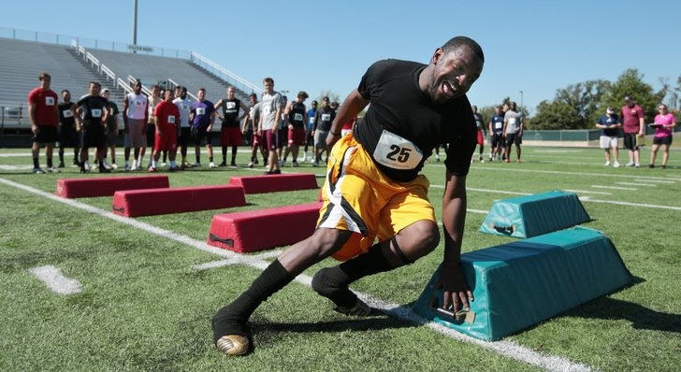
hustle- to hurry; work fast and energetically
The man hustled to finish to the race as quickly as he could.

Slide 3
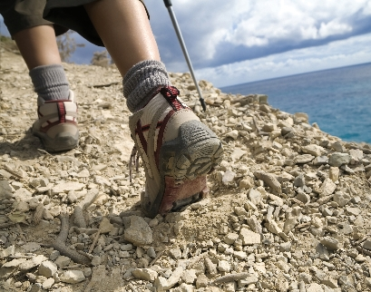
tramping- to walk with heavy feet
The lady was tramping up the side of the mountain.

Slide 4
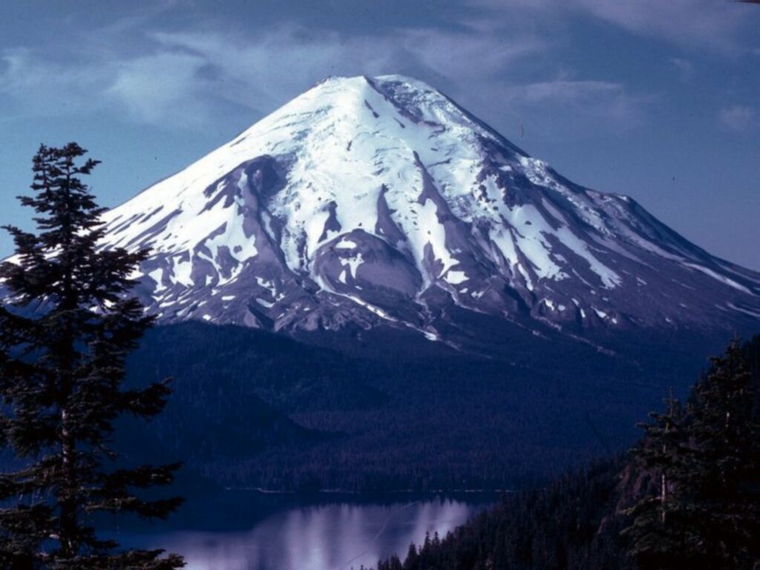
tremendous- really big, wonderful, fantastic (vast)
The mountain was absolutely tremendous.

Slide 5
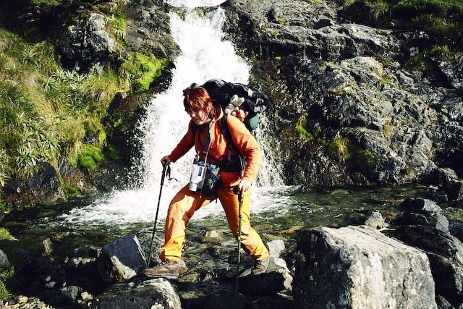
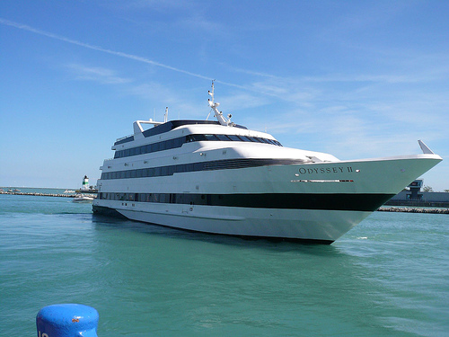
Which picture shows tramping?

Slide 6
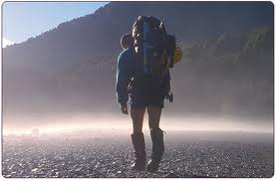
Which picture shows hustle?

Slide 7
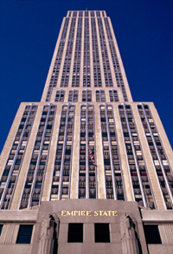
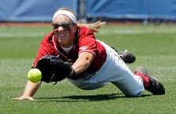
Which picture shows tremendous?

Slide 8
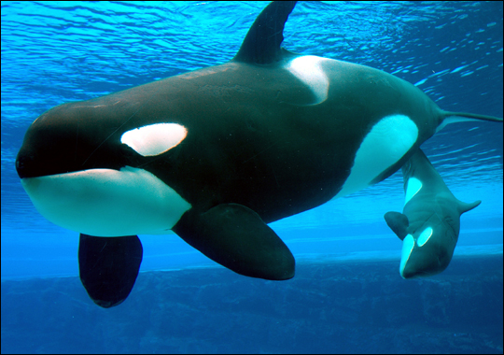
Which word goes with this picture: hustle, tramping, or tremendous?

Slide 9
Which word goes with this picture: hustle, tramping, or tremendous?

Slide 10
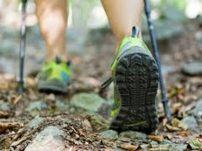
Which word goes with this picture: hustle, tramping, or tremendous?

